Slide 1

HOTEL MANAGEMENT SYSTEM
-N.Swapna sree
-t.Venkata vineesha
-b.manish reddy

Slide 2
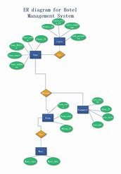
TABLE OF CONTENTS
Abstract
Introduction
Objectives
Literature survey
Results and Discussion
Conclusion and Future enhancement
References

Slide 3
ABSTRACT
Hotel management involves a multitude of operations that require seamless integration to provide optimal service to guests.
This project aims to develop a robust database management system that covers the essential functions of a hotel, including room reservations, employee management, customer details, billing, and inventory management.
The objective is to enhance operational efficiency and improve customer satisfaction through effective data management.
The primary objective of this project is to design and implement a relational database that can store and manage data related to hotel rooms, room categories, employees, customers, bookings, payments, food and beverages, and billing

Slide 4
INTRODUCTION
The hotel industry is characterized by its diverse operations, including front office management, room bookings, banquet services, finance, human resources, inventory management, housekeeping, and customer relationship management (CRM).
A well-designed database system can integrate these operations, providing a seamless flow of information and enhancing decision-making processes.
Effective management of a hotel involves the coordination of multiple departments and operations
This project aims to develop a robust database system to support the comprehensive management of hotel operations

Slide 5
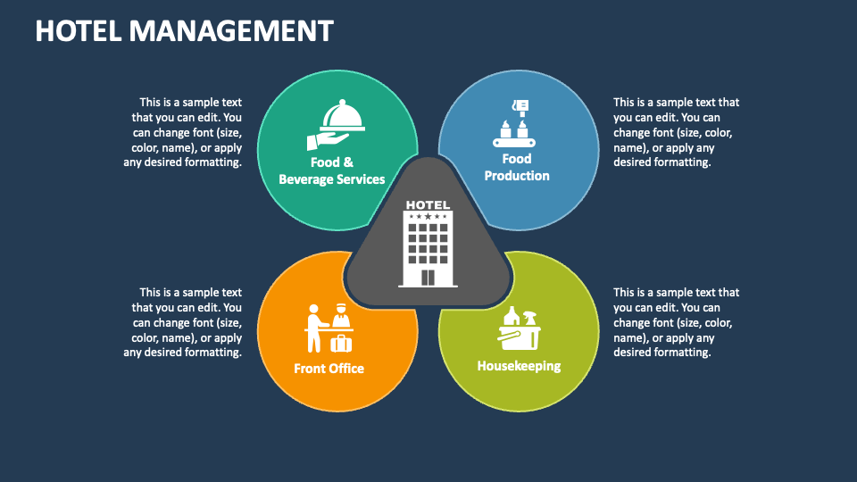
OBJECTIVES
The main objectives of this hotel management system using database management are
Scalable data schema,
Core features
Data Integrity
Performance optimization
Reporting capabilities
Integrating with other systems
Ensures security
Various access management

Slide 6
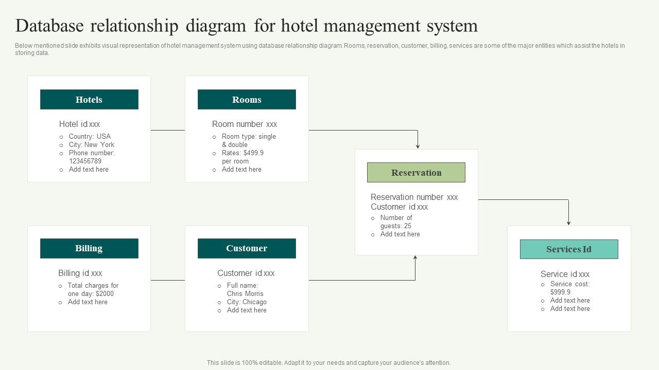
RESULTS AND DISCUSSION
The database system effectively manages guest information, room bookings, and basic reporting, streamlining hotel operations, but future enhancements and scalability considerations will be necessary to address more complex needs and integrations.
Improves operational efficiency by handling guest and booking data effectively, though it would benefit from additional features and scalability upgrades to better support future growth and advanced functionalities.

Slide 7
CONCLUSION
The hotel management system utilizing a database management system successfully streamlines key operational tasks, including guest information management, room bookings, and availability tracking.
By organizing and automating these processes, the system enhances efficiency and accuracy in hotel operations.
For future improvements, the integration of advanced features and scalability options will be essential to accommodate growing needs and ensure continued effectiveness in managing larger volumes of data and more complex functionalities.

Slide 8
FUTURE SCOPE
Advanced Features:Incorporate functionalities such as dynamic pricing, automated notifications, and personalized guest experiences to enhance service and operational efficiency.
Integration Capabilities: Develop interfaces for integration with online booking platforms, payment gateways, and third-party services to streamline operations and broaden the system's reach
Enhanced Reporting and Analytics: Implement advanced reporting tools and data analytics to provide deeper insights into booking trends, revenue, and guest preferences, aiding strategic decision-making.
Scalability and Performance: Optimize the system to handle increasing data volumes and user load, ensuring performance and reliability as the hotel grows.
User Experience Improvements: Enhance the user interface and experience for both hotel staff and guests, making the system more intuitive and accessible.

Slide 9
REFERENCES
-The Future of Hotel Management: Data-Driven Decision Making" by HospitalityNet (2022)
-Digital Transformation in Hospitality: Integrating CRM and ERP Systems" by Deloitte (2022)
-Enhancing Guest Experience with Mobile Solutionsby Oracle Hospitality (2023)
- Database Management Systems by Raghu Ramakrishnan and Johannes Gehrke(2023)
- Hotel Management System: Design and Implementation, International Journal of Computer Applications(2022)
- Relational Database Design and Implementation by Jan L. Harrington(2023)

Slide 10


